Slide 1

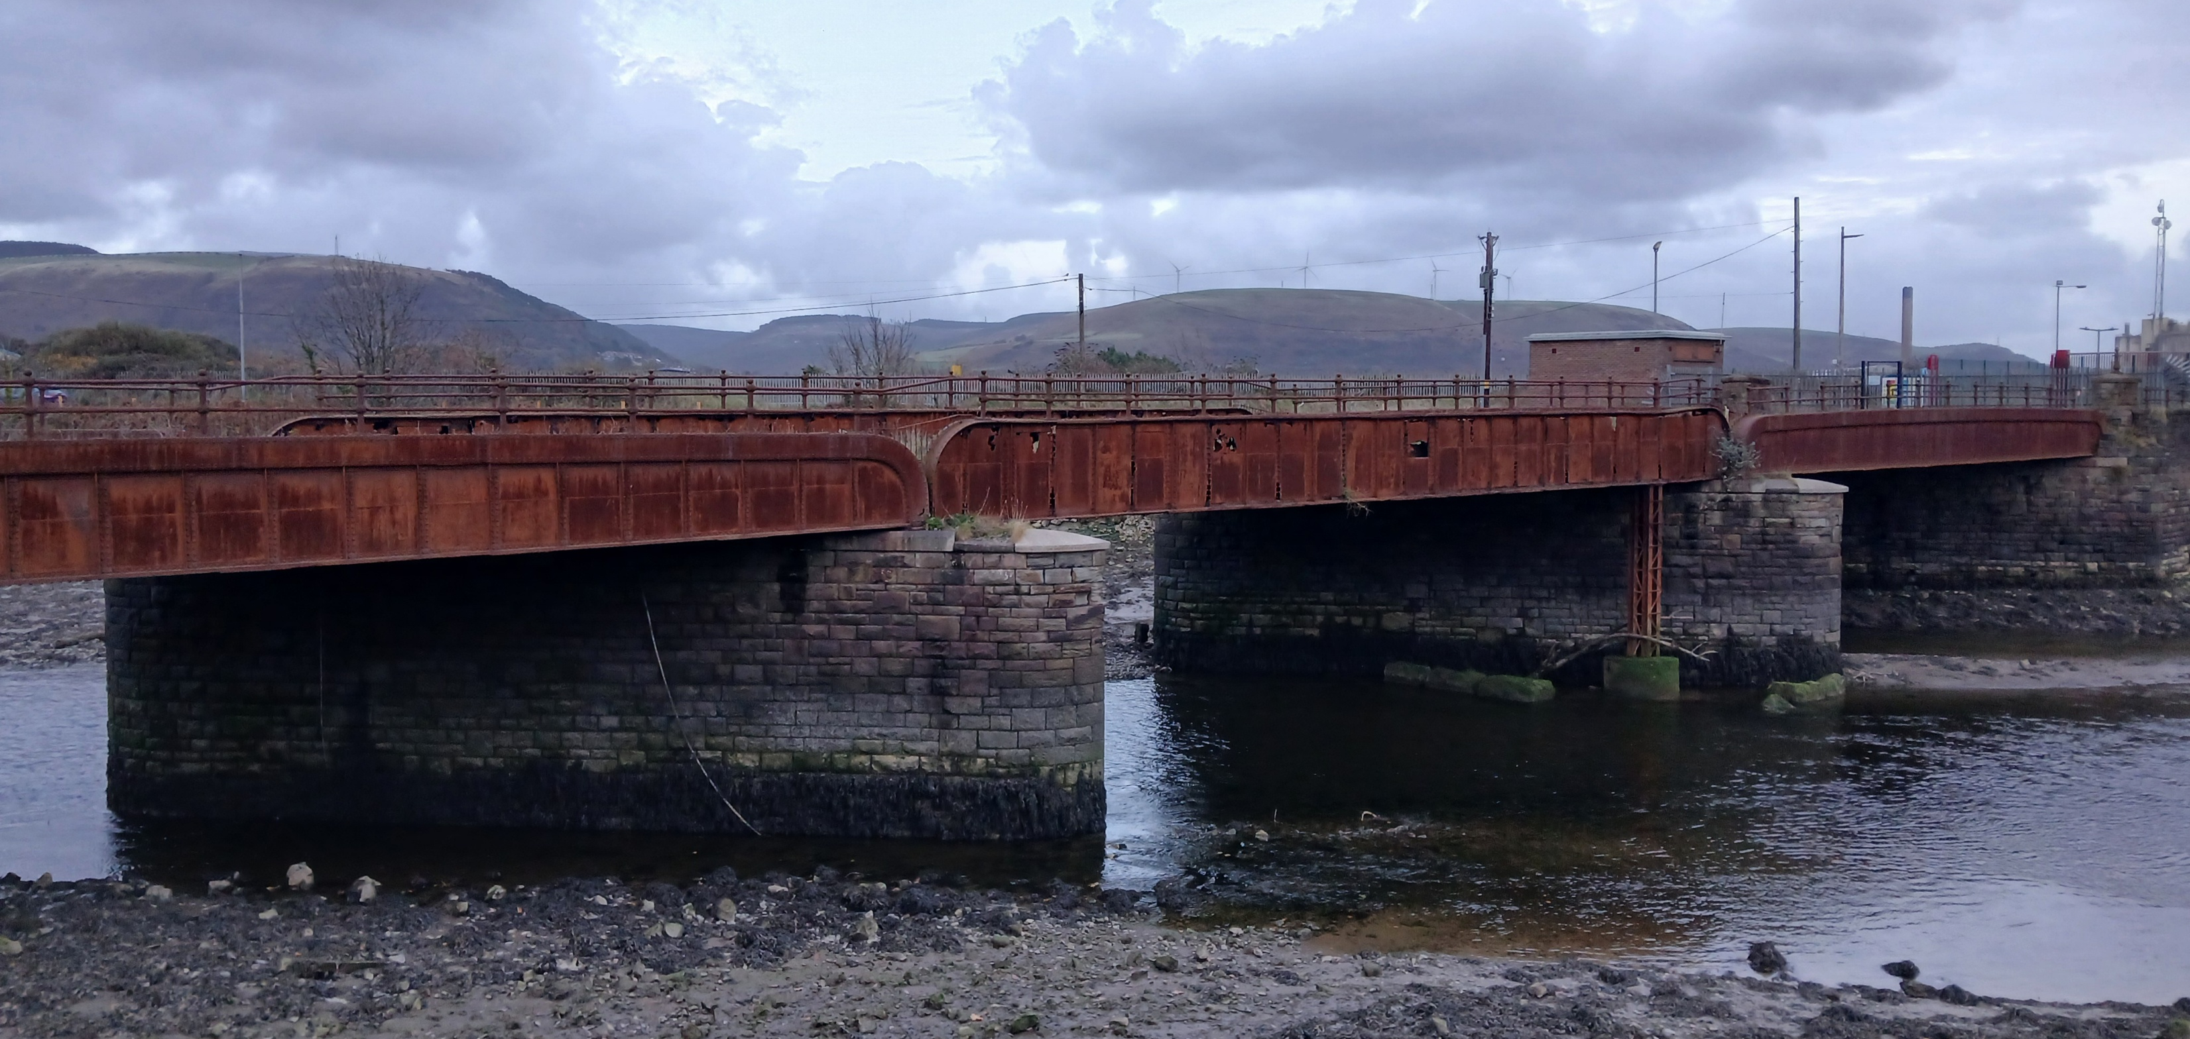


Newbridge Active Travel Link and Dock Access
Welcome to the Engagement Event
Neath Port Talbot Council is planning to restore the Grade II listed Newbridge Road bridge and re-open it as a pedestrian and cycle way to connect key parts of Port Talbot. We are looking for your feedback on the proposals to help ensure that the project meets your needs.
Please take your time considering the information available.
Representatives of Neath Port Talbot Council and their design consultants, Amey, will be happy to assist you with any queries you may have.
Your feedback is essential is ensuring that we deliver the right project.
You can access our feedback survey by scanning this QR code or completing a paper questionnaire at this event.
The survey will be open Monday 2nd February – Sunday 15th March 2026.

Slide 2
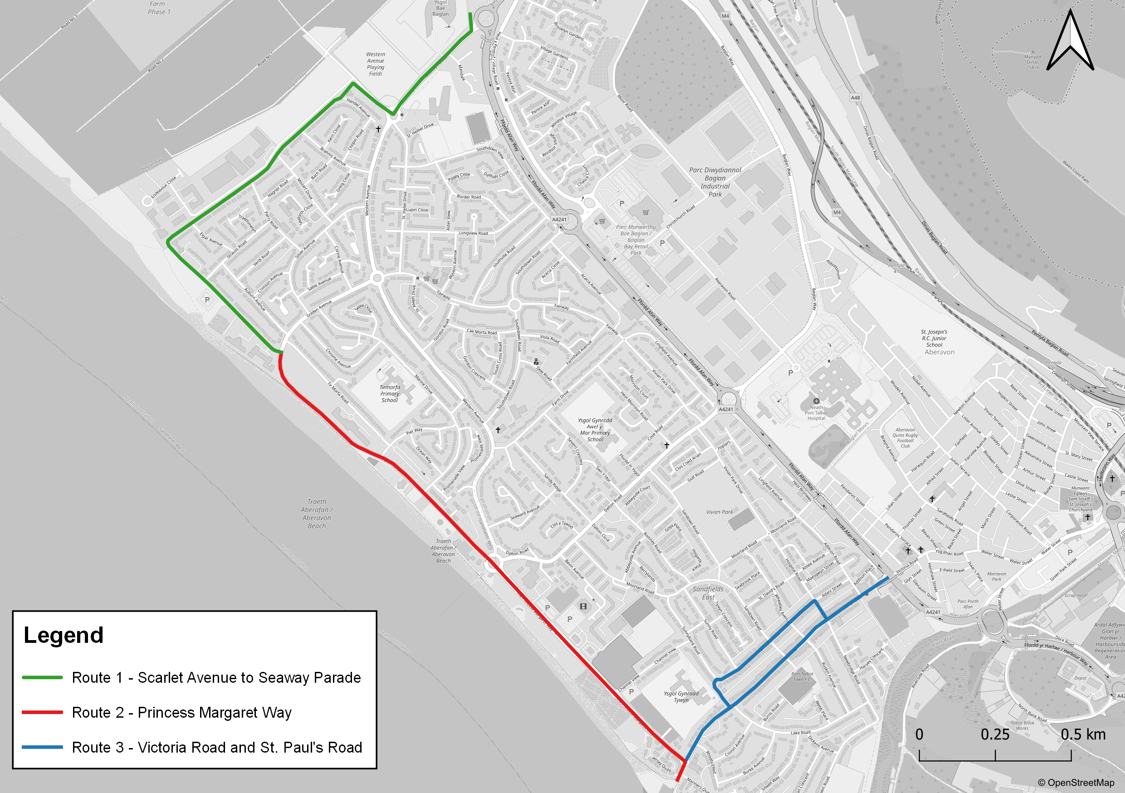
The project will restore the historic Newbridge Road Bridge and transform it into a new active travel link connecting Riverside Road and Newbridge Road.
The scheme also includes a new shared pedestrian and cycle route along Riverside Road and new traffic calming features on Newbridge Road to improve safety. This will connect to other proposed improvements within the Sandfields area.
This upgrade will create a safe, attractive, and mostly traffic-free route between Sandfields and the town centre, avoiding the heavily trafficked Victoria Road.
It will also improve access to the Port Talbot Docks area, which is set for regeneration to deliver new employment, housing, and retail opportunities.
Newbridge Active Travel Link
Other proposed improvements
What benefits will re-opening the bridge bring to the community?
Provides a safe route for pedestrians and cyclists between Sandfields, the town centre, and Port Talbot docks, making jobs and training opportunities more accessible without a car.
Restores the deteriorated Grade II listed bridge, protecting an important historical asset for future generations.
Encourages walking and cycling, helping residents adopt healthier lifestyles.
Improves the active travel network in Port Talbot and its connections to national cycle routes

Slide 3
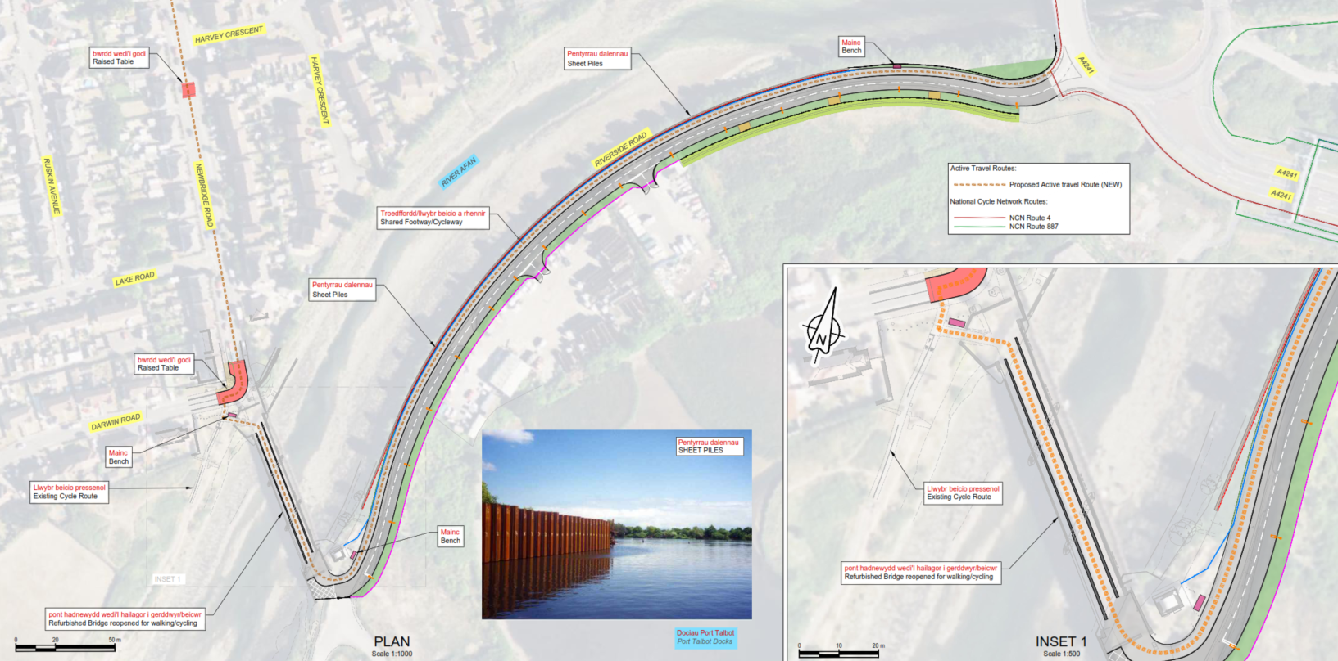
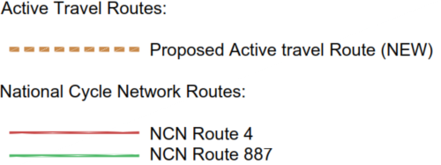
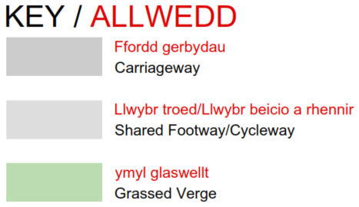
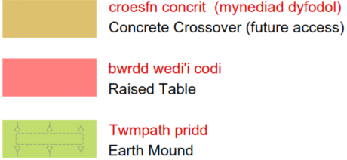
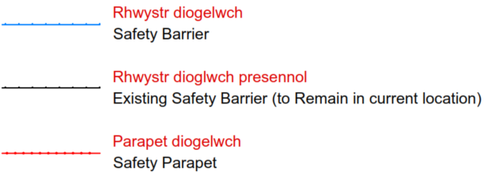
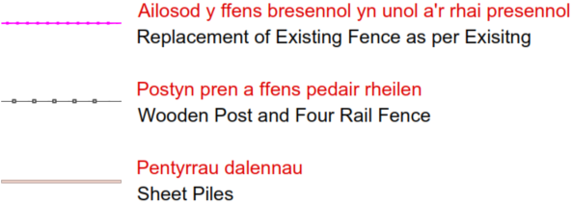
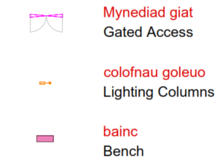
Proposed layout of Newbridge Road Bridge and active travel improvements

Slide 4

How will the project be funded?
Neath Port Talbot Council have been successful in securing funding from the UK Government’s Levelling Up Fund which will be used to deliver regeneration projects in Port Talbot.
Project timescales – what happens next?
Feb. 2026
Public Consultation (6 weeks) - This public consultation will gather feedback on the proposals which will be used to shape the final scheme design.
Apr.–Dec. 2026
Detailed design and tender (8 months) - Final design will be developed, taking into account feedback from public and stakeholder engagement
Jan.–Dec. 2028
Construction of scheme (12 months)
2029
Scheme open for use

Slide 5
How do I provide feedback?
Ask questions
We would love to know your thoughts. The project team at this exhibition would be happy to discuss any aspects of the project with you.
Complete a feedback questionnaire
Your feedback is essential is ensuring that we deliver the right project for your community. Please share your views by completing the survey available online or in paper copies at the exhibitions.
The survey is open from Monday 2nd February – Sunday 15th March 2026.
The online survey can be accessed by scanning this QR code.
Thank you for taking part in this consultation.
To access this exhibition online, please visit: https://www.npt.gov.uk/activetravel#consultations

